Slide 1

Deepfake
And
Dilemma
CSE487
Presentation

Slide 2




Do nothing?
Portrays as weak
In the case of an invasion the state remains unprepared with no defense
Increases the possibilities of future invasion plan
No funds wasted
No workforce wasted
Can a avoid potential war and bloodbath of millions
Alfe Suny
Dep of CSE
2019-3-60-010

Slide 3
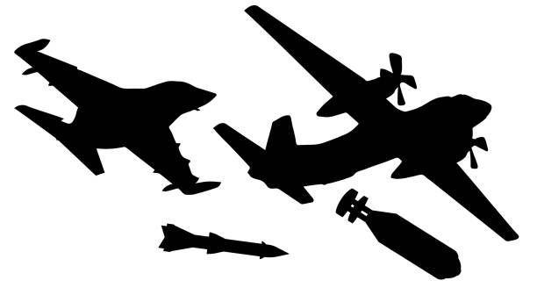
Let there be war !
Fully Nullify rival country
Sends a strong signal of dominance to other rivals
Innocent lives at stake
Resource Wasted
Potential War and Bloodbath

Slide 4

Shields up !
Prepared for countermeasures if something happens
Avoids potential war and bloodbath of millions
Resources wasted if no invasion was planned

Slide 5

Take counter measures

Slide 6
Thank You

